Slide 1
Robot Operating System (ROS)
Robotics middleware (software frameworks for robot software development) in C++/Python
Application Packages – SLAM mapping, localisation, control, communication, processing
Hardware Packages – LIDAR, camera, imu, sensors, motor drivers, encoders, microcontroller
Service Packages - serial connection, transform publisher, laser inverter, map server
Computer on Robot
Laptop
ROS Master
Registration
Registration
Registration
Camera Node
Image Processing Node
Image Display Node
Data
Publish
Subscribe
Subscribe
Camera
/image_data Message

Slide 2
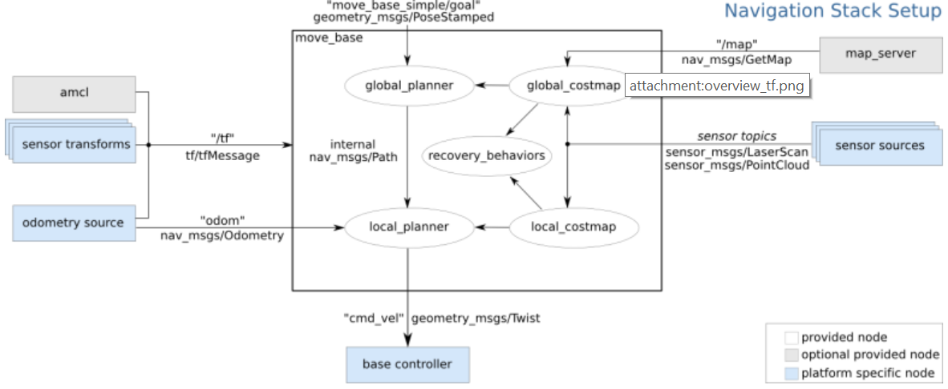
ROS Navigation Stack
Collection of packages for path planning in a static map.
Real Examples [1] [2]
Simulated Examples [1] [2]

Slide 3
Problem and Solution
Problem Statement
A lot of time is required to tune the navigation stack with every new environment, and new adjustments to robot
Many parameters to tune for each package which are interdependent on each other, this makes the system as a whole difficult to tune as cause and effect in system are hard to correlate
Solution
1. Treat as a global blackbox optimisation problem by treating the whole navigation stack as the search space
2. Treat small test movements as objective function

Slide 4
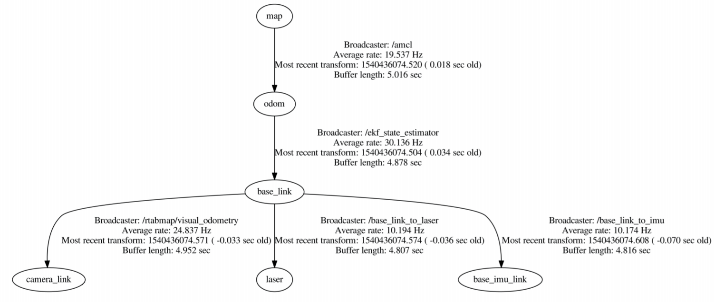
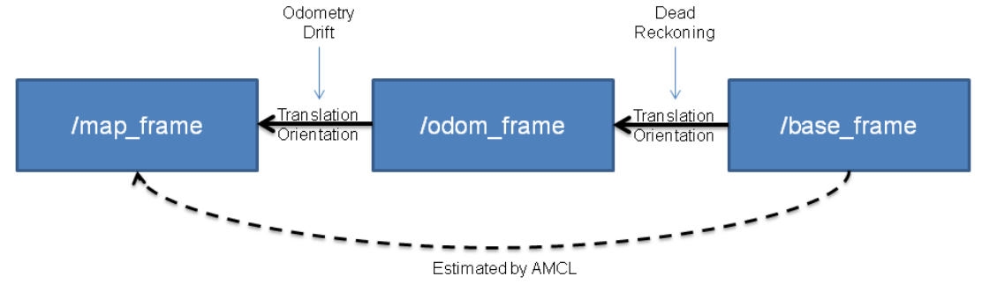
Estimating robot position in ROS
Localisation Package –> Global map position
Adaptive Monte Carlo Localisation (AMCL) Particle Filter [1]
Real-Time Appearance-Based (RTAB) Localisation [1]
Sensor Fusion Package -> Local map position
EKF Localisation for Sensor Fusion for odometry [1]
UKF Localisation
Sensors-> affect EKF update
IMU
Lidar
IMU

Slide 5
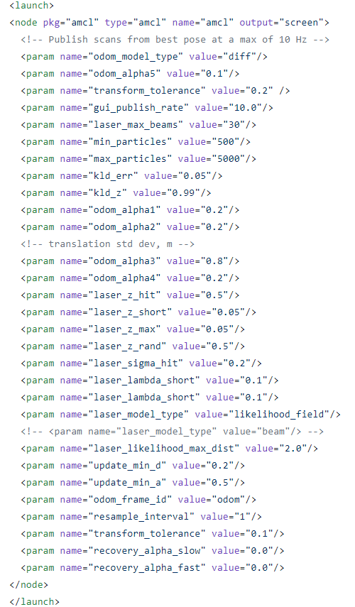
Parameters
Adaptive Monte Carlo Localisation (AMCL) [1]
Adaptive particle filter
Overall filter
Laser Model
Odometry Model

Slide 6
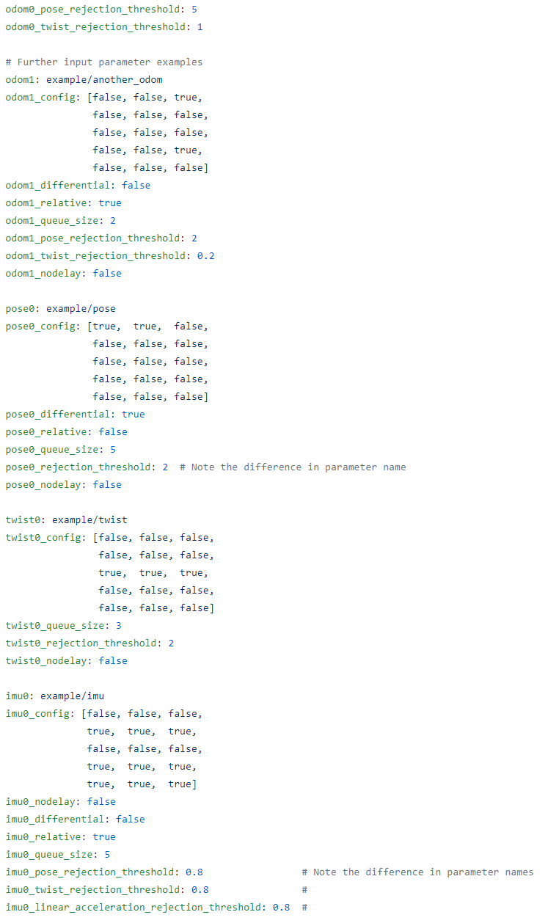
Parameters
EKF Localisation [1]
Every sensor input –
Customise input:
x, y, z, roll, pitch, yaw, vx, vy, vz, vroll, vpitch, vyaw, ax, ay, az
Customise how much each sensor contribute to filter: Pose/twist rejection threshold

Slide 7
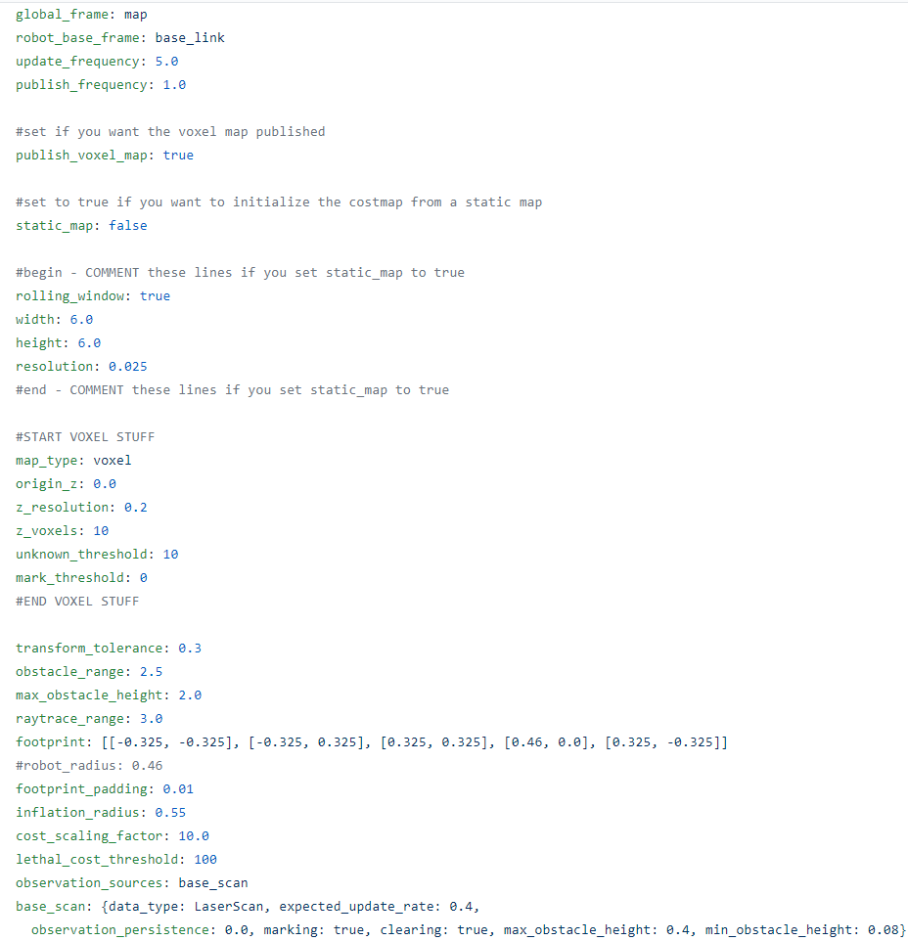
Cost Maps
[1]
Every sensor input –
Inflation radius
Transform Tolerance
Update Frequency

